Slide 1

Used Cars - Uncovering Factors That Affect Used Car Prices
MATH 3620 – Statistical Methods II
Aiden Rader
Notes:
Hello, I’m Aiden, and today I’ll be presenting my multiple linear regression analysis on used car prices.
The goal is to understand which factors influence price and how strongly they affect it.

Slide 2
Introduction / Purpose
Used car prices vary widely due to multiple interacting factors
Understanding these relationships requires statistical modeling
Research Question: Which factors significantly influence used car prices?
Approach:
  Use real-world data
  Apply statistical modeling (MLR)
  Evaluate significance and model performance
Note: This is an observational dataset, not experimental
Notes:
Used car prices can vary significantly depending on a number of factors such as age, mileage, and condition.
Because multiple variables influence price at the same time (i.e. brand, vehicle age, condition, etc.), we need a statistical approach that can analyze these relationships simultaneously.
So the main research question becomes: which factors have a significant impact on price?
To answer this, we use real-world data collected via the used car market and apply multiple linear regression to model and evaluate these relationships.

Slide 3
Why Multiple Linear Regression?
MLR | ANOVA
Model's multiple predictors simultaneously | Compares group means
Handles continuous + categorical variables | Primarily categorical
Produces predictive equation | No predictive model
Estimates individual variable effects | Tests overall differences only
Therefore, MLR is more appropriate for modeling and predicting used car prices in a multi-factor setting!
Notes:
I chose Multiple Linear Regression because we’re trying to model price using several variables at the same time.
While ANOVA is useful for comparing group means, it doesn’t allow us to build a predictive model or measure the impact of multiple variables simultaneously.
ANOVA would require simplifying the problem too much, we’d lose important relationships between variables.
Since our dataset includes both continuous and categorical variables, MLR is the most appropriate method for this analysis.

Slide 4
Dataset Overview
Source: Used car listings from eBay Kleinanzeigen (1)
  Collected via web scraping (Data.World, @data-society)
  Timeframe: March-April 2016
  Original data in German
Sample Size: ~246,000 (after cleaning)
Response variable (Y): price_euros (continuous)
Explanatory variables (X):
  Quantitative: model_age, km, ps
  Categorical: gearbox, not_repaired_damage
  Additional considered: fuel_type, vehicle_type, brand
1. Koehne, J. (2016, November 22). Used Cars Data - dataset by data-society. data.world. https://data.world/data-society/used-cars-data
Notes:
The dataset I used comes from Data.World, where a team called Data Society collected used car listings by web scraping eBay Kleinanzeigen between March and April of 2016.
After cleaning, the dataset contains about 246,000 observations.
Our response variable is price in euros, which we treat as a continuous variable.
The predictors include quantitative variables such as model age, mileage, and power, along with categorical variables like gearbox type and whether the car has unrepaired damage.
I also explored additional variables like fuel type, vehicle type, and brand to see whether they improved the model.
Original Variables:
price : the price on the ad to sell the car (in euros)
vehicleType: if the vehicle is an SUV, sedan, etc (later grouped better)
Model_year : at which year the car was first registered (later used to create model_age)
Gearbox: what type of transmission does the vehicle have
powerPS : power of the car in PS (German version of horsepower but not equivalent)
kilometer : how many kilometers the car has driven
fuelType: type of fuel vehicle takes (i.e. gasoline, diesel, lpg, etc.)
Brand: brand of the vehicle (i.e. ford, bmw, etc.)
notRepairedDamage : if the car has a damage which is not repaired yet

Slide 5
Data Cleaning Process
Real-World Data Issues
Irrelevant variables (IDs, timestamps, etc.)
Inconsistent formats (German labels)
Unrealistic values (price, year, power)
Cleaning Steps
Removed unnecessary variables
Filtered unrealistic/invalid values
Standardized categorical variables
Created “model_age”
Simplified categories
Notes:
The raw dataset had several real-world issues, including irrelevant variables, inconsistent formatting due to German labels, and unrealistic values.
To address this, I cleaned the data by removing unnecessary variables, filtering/removing invalid values, standardizing fields, and creating new features like model_age using 2016 - model_year. I also simplified categorical variables so they could be used in regression.
This ensured the dataset was reliable and ready for modeling.

Slide 6
Data Cleaning Pipeline
Raw Data
German Labels
Filtering
Remove invalids
Standardization
Feature Engineering
Clean labels
Create “model_age”
Final Data
Clean
Missing Values
Noisy entries
Drop columns
Fix Formats
Simplify types
Structured
Ready
Notes:
As you can see here this was my ideology behind my data cleaning!

Slide 7
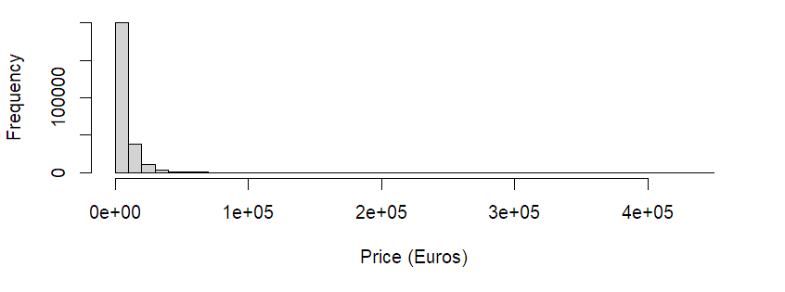
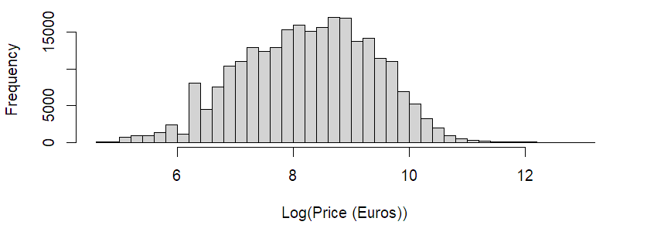
Price Distribution & Log Transformation
Raw Price Distribution
Log-Transformed Price Distribution
Figure 1: Raw Distribution of car prices using R histogram
Figure 2: Log Distribution of car prices using R histogram
Highly right-skewed (long tail)
Few extremely expensive cars
Most observations clustered at low prices
Distribution becomes more symmetric
Reduces impact of extreme values
Better suited for multilinear regression
Log transformation helps satisfy linear regression assumptions (normality & constant variance)
Notes:
This is meant to fix skewed data…
The original price distribution was heavily right-skewed, meaning most cars were low-priced with a few very expensive outliers.
When I apply a log transformation, it compresses those extreme values and gives me a much more symmetric and balanced distribution. This improves: model stability, interpretation and regression assumptions.
That makes the data more appropriate for my multilinear regression.

Slide 8
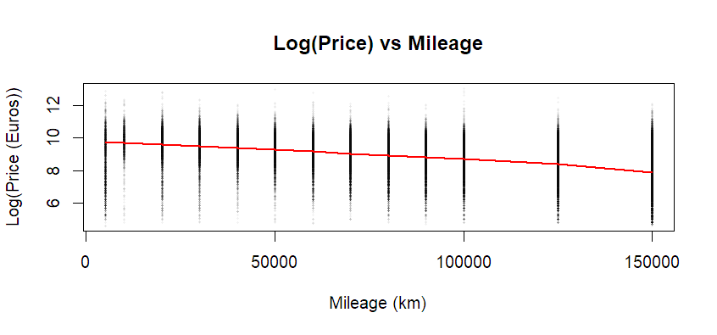
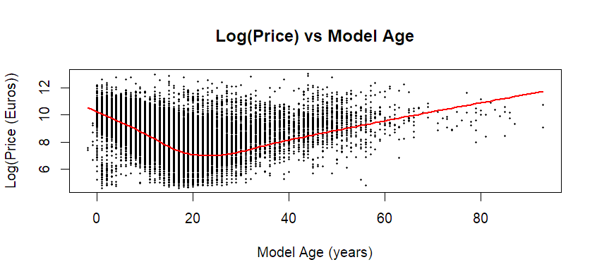
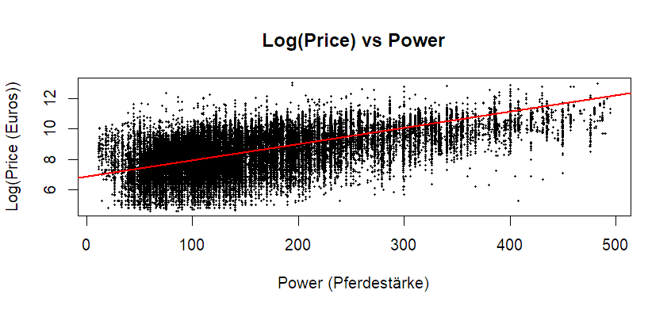
Exploratory Data Analysis (EDA) - Continuous Variables
Plots:
Mileage (km)
Model Age
Power (Pferdestärke)
Interpretation:
Price decreases as mileage increases
Price generally decreases with age (non-linear relationship)
Price increases with engine power
Relationships are not strictly linear
Notes:
Understanding the relationships visually…
We observe a negative relationship between mileage and price.
Model age shows a non-linear pattern newer cars are expensive, prices drop, then stabilize.
If asked about the curve I can say: This likely reflects depreciation patterns and potential collector effects in older vehicles.
Power has a clear positive relationship with price
Overall, these relationships are clear but not perfectly linear, which justifies using regression.

Slide 9
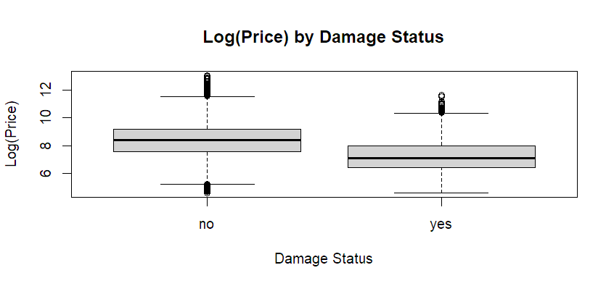
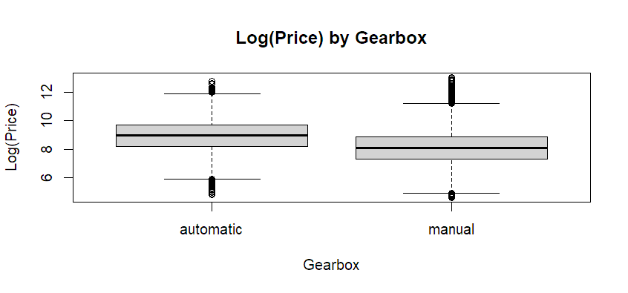
Exploratory Data Analysis (EDA) - Categorical Variables
Plots:
Damage Status
  If it is repaired or not / has damage
Gearbox
Interpretation:
Cars with unrepaired damage have significantly lower prices
Automatic vehicles tend to be priced higher than manual
Strong group differences justify inclusion of categorical predictors
Figure 6: Categorical boxplot given if a vehicle is damaged or not, made with R boxplot()
Figure 7: Categorical boxplot given a vehicles transmission type, made with R boxplot()
Notes:
Here we are looking at categorical variables using boxplots:
Vehicles with unrepaired damage are clearly cheaper which theoretically makes sense given what we may know about buying a broken or damaged vehicle.
Transmission type also impacts price, with automatics generally being higher. This makes sense since our data comes from Europe where automatic is considered a luxury.

Slide 10
Correlation Analysis
Interpretation:
Strong positive correlation:
  Power (ps) increases price (r ~ 0.57)
Moderate negative correlations:
  Model age decreases price (r ~ -0.57)
  Mileage decreases price (r ~ -0.45)
Weak correlation:
  Mileage and power are nearly unrelated (r ~ 0)
No strong multicollinearity observed between predictors, we can use these as the base model.
 | Log(price) | model_age | km | ps
Log(price) | 1.000 | -0.568 | -0.446 | 0.565
model_age | -0.568 | 1.000 | 0.388 | -0.203
km | -0.446 | 0.388 | 1.000 | -0.016
ps | 0.565 | -0.203 | -0.016 | 1.000
Table 1: Correlation Table, data from R
Notes:
This is to check for multicollinearity…
Highlight:
Price vs age -> negative (as the car gets older, price goes down, besides the outlier we saw earlier)
Price vs km -> negative (as the car gains mileage, the price will also go down)
Price vs power -> positive (if a cars power is higher, the price typically increases)
Negative = opposite directions
Positive = same direction
As we can see with the correlation table, there seems to be no multicollinearity observed between the baseline predictors, hence why they were chosen for our baseline.

Slide 11
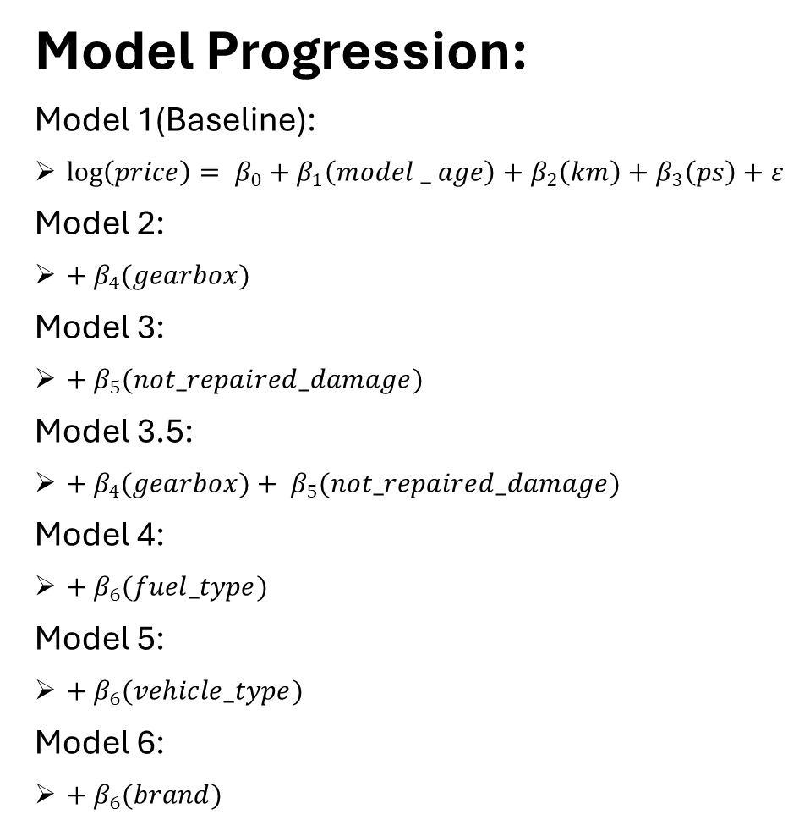
Model Development
Model Progression:
Model 1(Baseline):
$\log\left(price\right)= β_{0}+β_{1}\left(model _ age\right)+β_{2}\left(km\right)+β_{3}\left(ps\right)+ε$
Model 2:
$+ β_{4}(gearbox)$
Model 3:
$+ β_{5}(not_repaired_damage)$
Model 3.5:
$+ β_{4}(gearbox)+ β_{5}(not_repaired_damage)$
Model 4:
$+ β_{6}(fuel_type)$
Model 5:
$+ β_{6}(vehicle_type)$
Model 6:
$+ β_{6}(brand)$
Approach:
Used a stepwise model building approach
Started with key continuous variables
Gradually added categorical predictors
Compared models using R² and statistical significance
NOTE: Categorical variables were included using indicator (dummy) variables
Notes:
Using a stepwise model building design, which is adding a new variable to every step and recording results which we will see our best results compared on the next slide!
We started with a baseline model using key continuous predictors, then incrementally added categorical variables to evaluate how each affected model performance.
Each model was compared using R² and statistical significance

Slide 12


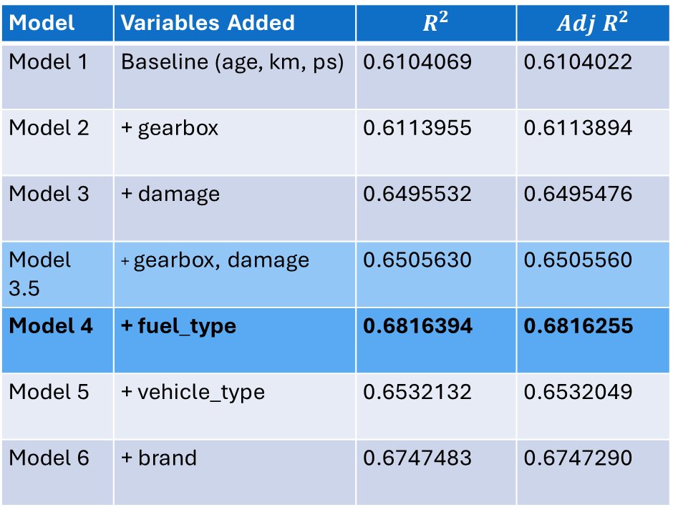
Model Comparison
Model | Variables Added | $$R^{2}$$ | $$Adj R^{2}$$
Model 1 | Baseline (age, km, ps) | 0.6104069 | 0.6104022
Model 2 | + gearbox | 0.6113955 | 0.6113894
Model 3 | + damage | 0.6495532 | 0.6495476
Model 3.5 | + gearbox, damage | 0.6505630 | 0.6505560
Model 4 | + fuel_type | 0.6816394 | 0.6816255
Model 5 | + vehicle_type | 0.6532132 | 0.6532049
Model 6 | + brand | 0.6747483 | 0.6747290
Key Insights:
Model 4 achieves the highest performance $(Adj R^{2}=0.682)$
Model 3.5 provides a strong, more interpretable alternative
Additional variables beyond Model 4 show diminishing returns
Table 2: $R^{2}$Table, data from R
Notes:
This table compares all models using R² and adjusted R²
Model 4 performs the best and achieves the highest performance, but Model 3.5 is a strong simpler alternative.
Adding more variables beyond Model 4 doesn’t improve much, it actually has diminishing returns since both of them introduced varying categorical variables that made it more complicated then needs be.

Slide 13
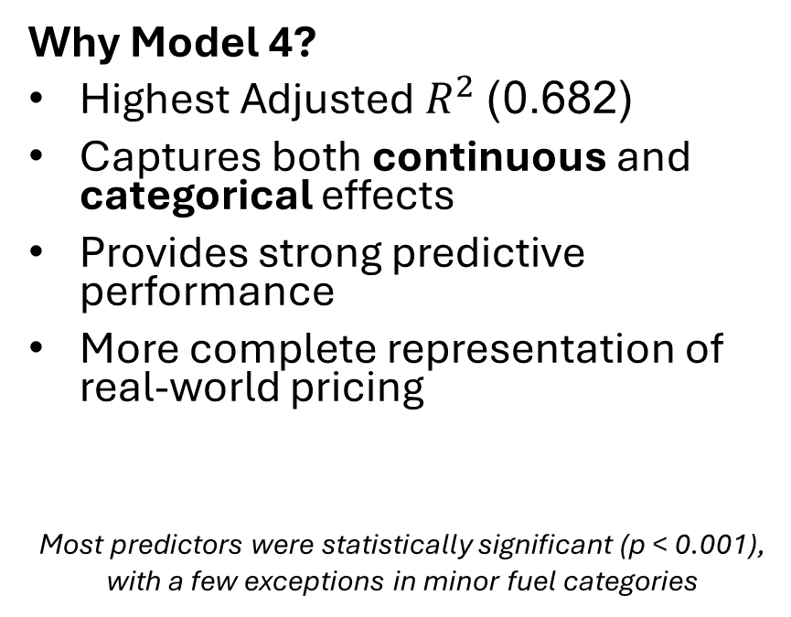
Final Model Selection
$$\log\left(price\right)= β_{0}+β_{1}\left(model _ age\right)+β_{2}\left(km\right)+β_{3}\left(ps\right)+ β_{4}(gearbox)+ β_{5}(not_repaired_damage)+ β_{6}(fuel_type)+ε$$
Why Model 4?
Highest Adjusted $R^{2}$(0.682)
Captures both continuous and categorical effects
Provides strong predictive performance
More complete representation of real-world pricing
Most predictors were statistically significant (p < 0.001), with a few exceptions in minor fuel categories
Interpretation:
Older cars tend to have lower prices
Higher mileage decreases vehicle value
Greater engine power increases price
Vehicles with damage are significantly cheaper
Automatic vs manual transmission impacts price
Fuel type contributes additional explanatory power
Notes:
Model 4 was selected because it balances performance and interpretability while capturing both continuous and categorical effects.
Most variables are statistically significant, meaning they meaningfully contribute to explaining price variation.

Slide 14
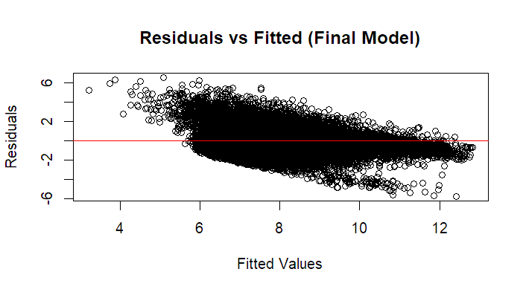
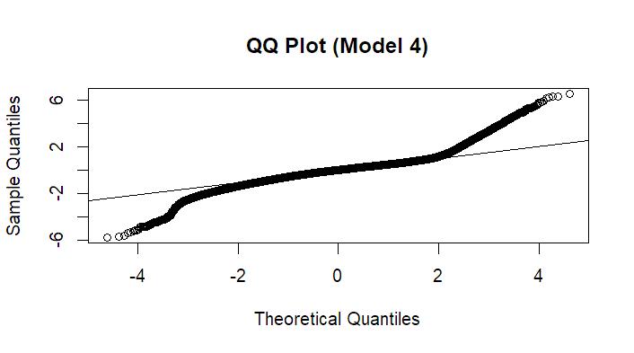
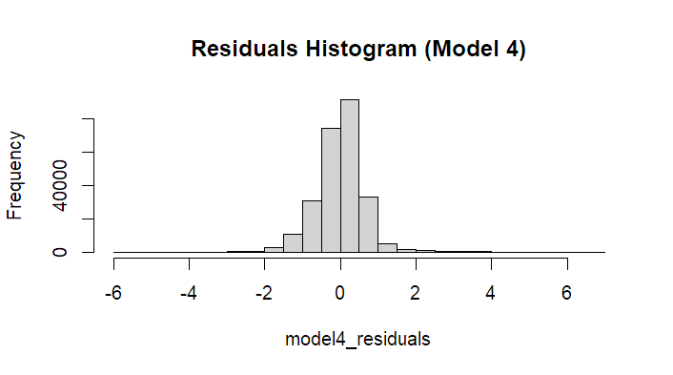
Model Diagnostics
Residual Patterns:
Residuals are centered around zero
The spread changes slightly across fitted values
Normality:
Residuals are approximately normal
Slight deviations in extreme values
Conclusion:
Model assumptions are reasonably satisfied
Minor patterns are expected with large real-world data
Model still remains appropriate for analysis
Notes:
I evaluated the model using residual plots
Residual vs. Fitted Plot
Residuals are centered and roughly normal, which is a good sign
There are minor deviations, but that’s expected with large real-world datasets
QQ Plot
Residuals are approximately normal, with slight deviations in extreme values
Histogram
The distribution is roughly bell shaped so it looks normally distributed!

Slide 15
Conclusive Interpretations
Each additional year ~ 4.4% decrease in price
Milage (-9.61e-06 per km)
For every +10,000km ~ 9.6% decrease in price
Power / PS (+0.00849)
For every +10 PS ~ 8.5% increase in price
Unrepaired Damage (-0.7509)
Vehicles with damage ~ 53% lower price then those without damage
Gearbox (Manual vs Automatic: -0.0362)
Vehicles with a manual gearbox ~ 3.6 % lower than automatic
Fuel Types:
Diesel (+0.159) ~ 17% higher
Gasoline (-0.0307) ~ 3% lower
Hybrid (+0.145) ~ 16% higher
LPG (-0.0295) ~ 3% lower
Electric ~ not statistically significant
Model Age (-0.0455)
Key Takeaways:
Out of the variables tested in our model: vehicle age, mileage, and damage have the largest negative impact on price
Engine power and fuel type contribute positive value differences
Damage status is one of the strongest predictors of price
Notes:
Now that we have chosen our model, ran the statistical analysis tests on the model
We can now quantify effects:
Age and mileage reduce price
Power increases price
Damage has a very large negative effect
Overall, these factors explain a large portion of price variation

